Slide 1

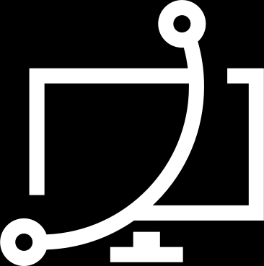
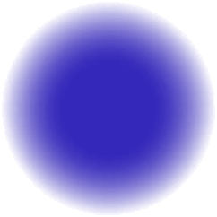


CA2
DEEP
LEARNING
By PinPin x Shane

Slide 2
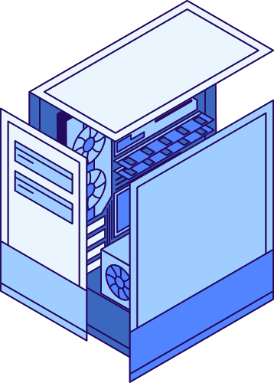
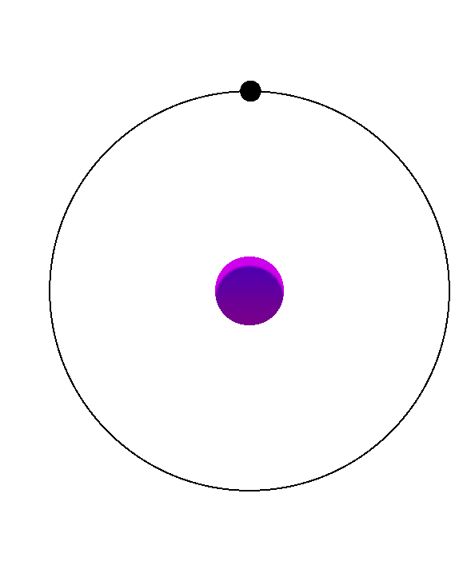
2.
GENERATIVE ADVERSARIAL NETWORK

Slide 3

3.
BACKGROUND INFO
Generating Realistic Images
Use Cases
It greatly enhances efficiency and scalability, allowing businesses and individuals to produce high-quality images quickly and cost-effectively.
Down Side:
The technology can be misused to create deepfakes or misleading information, raising ethical concerns. It might also reduce job opportunities for traditional artists and designers.

Slide 4
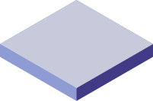
4.
TABLE OF CONTENTS
Dataset Exploration
Dataset Processing
Model Selection
Model Improvement

Slide 5

5.
DATASET
EXPLORATION

Slide 6
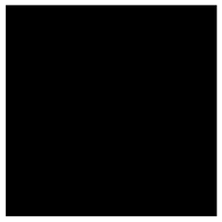
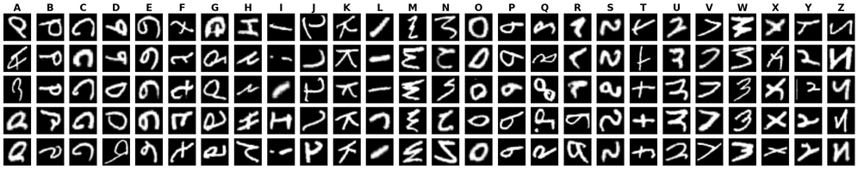
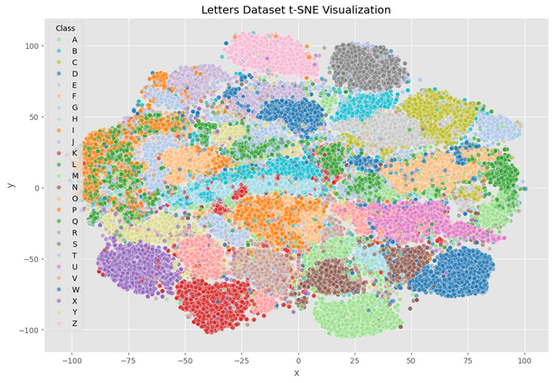
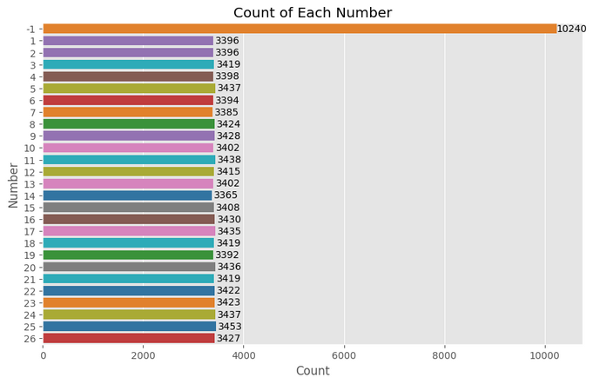
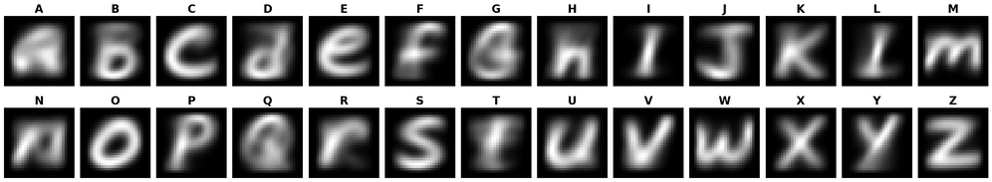
6.
DATA INFORMATION
Dataset
Label (-1) Was just a blank Image
Images (99040, 28, 28)
Labels (-1 | 26)
Raw Images
t-SNE Distribution
Count of Labels
Average Pixel Images

Slide 7
7.
DATASET
PROCESSING

Slide 8
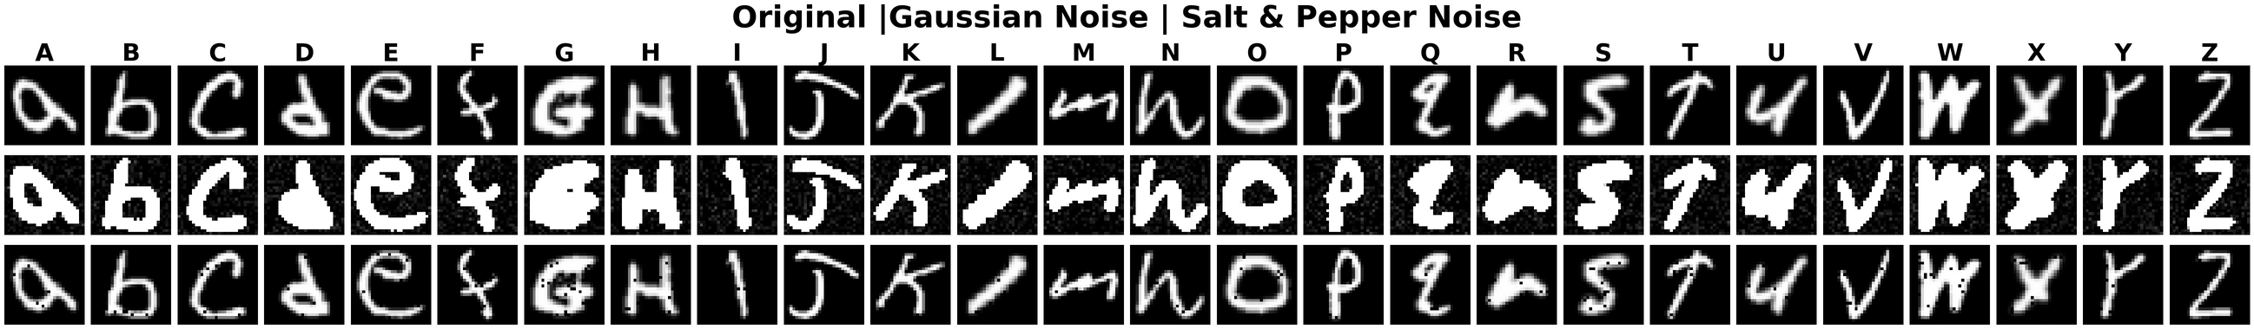
8.
DATA PROCESSING
Data Augmentation
Gaussian Noise
A type of statistical noise that has a probability density function (PDF) equal to that of the normal distribution
Salt & Pepper Noise
It presents itself as randomly scattered white (salt) and black (pepper) pixels. It represents a type of impulsive noise
Mean (μ) = 0
Standard Deviation (σ)
Density = Area Affected

Slide 9
9.
MODEL
SELECTION

Slide 10
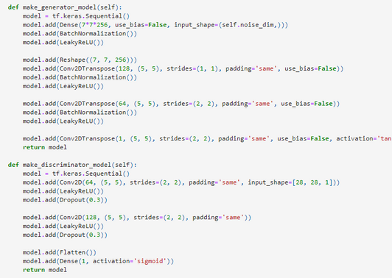
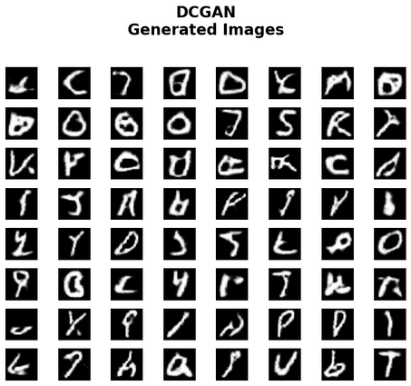
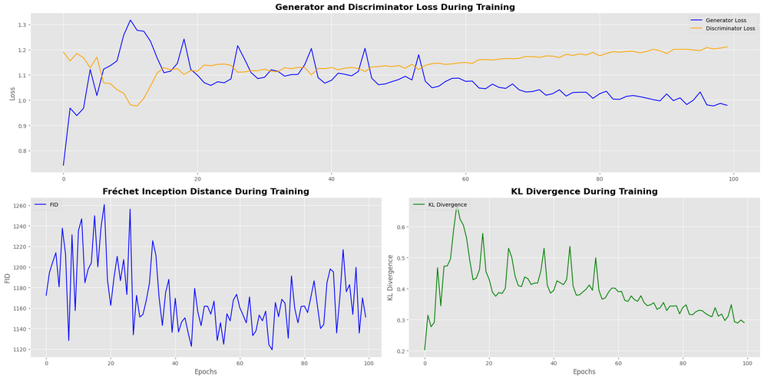
MODEL BUILDING (BASELINE)
10
Observation
D & G are diverging (Discriminator too strong)
KL Divergence slowing decreasing
FID fluctuating
Model Architecture
Discriminator
2 Conv Layer
Generator
3 Conv Layers

Slide 11
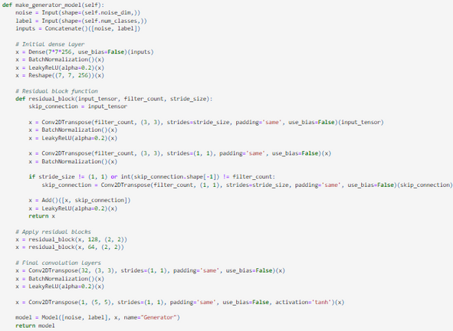
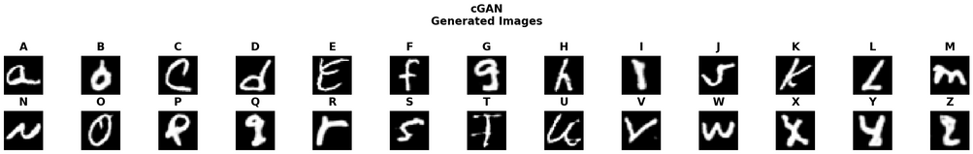
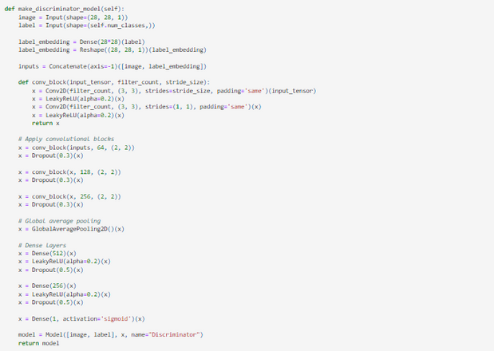
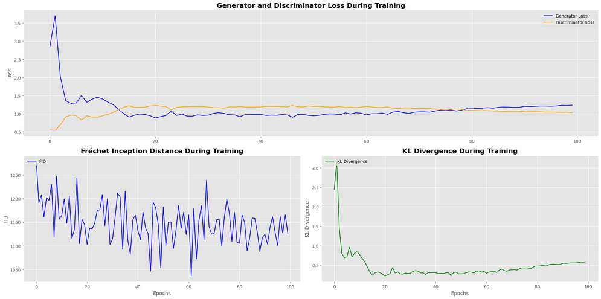
MODEL BUILDING (CGAN)
11
Observation
Both losses stabilize after initial fluctuations
KL Divergence dropped but slowly rises (Overfitted)
FID score fluctuating
Model Architecture
Both D & G take in the (Labels & Images) as Inputs.
Same Architecture as Improved DCGAN

Slide 12
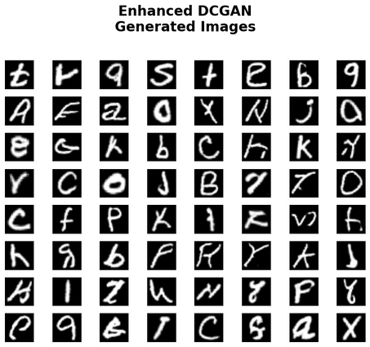
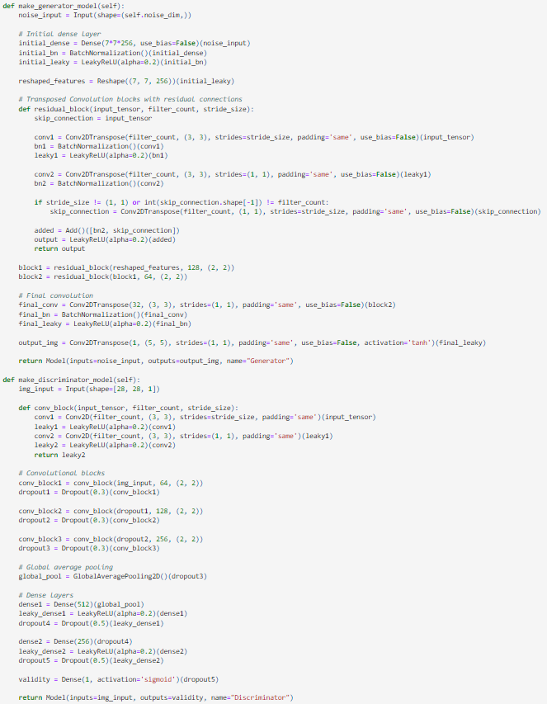
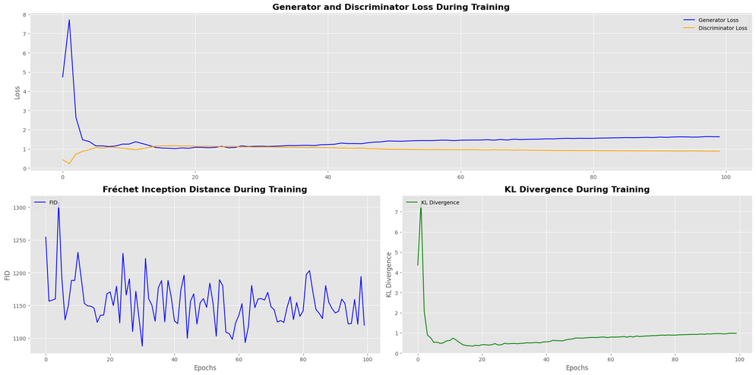
MODEL BUILDING (IMPPROVED)
12
Observation
D & G are diverging (Discriminator too strong)
FID fluctuating
KL Divergence shows overfitting (Big Drop then Rise)
Model Architecture
Discriminator
6 Conv Layer
Generator
7 Conv Layers
Added Global average pooling

Slide 13
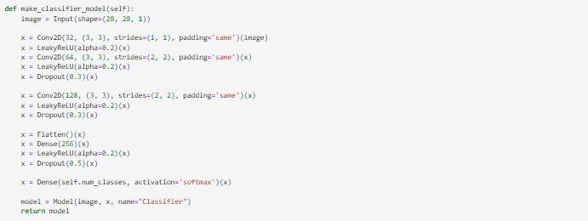
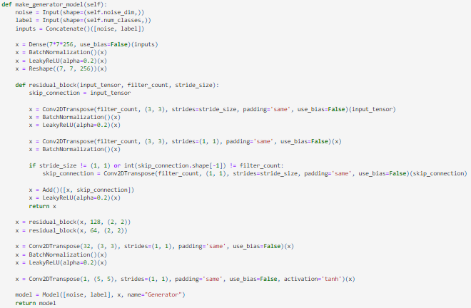
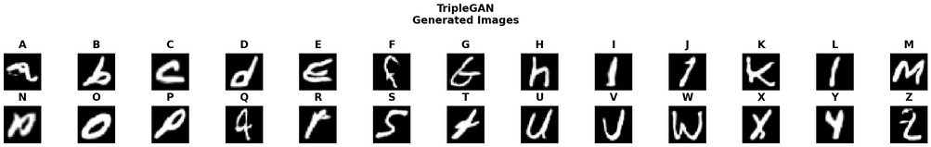
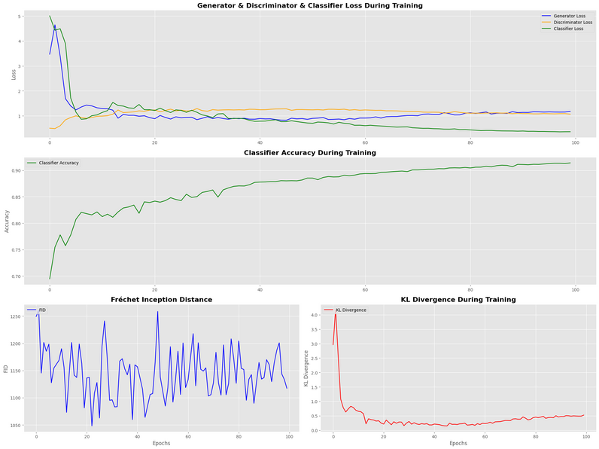
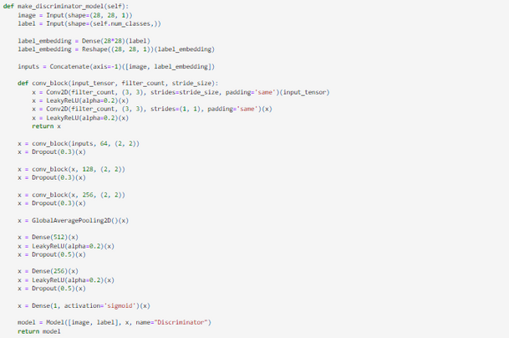
MODEL BUILDING (TRIPLE-GAN)
13
Observation
Both losses stabilize after initial fluctuations
KL Divergence is very very high.
FID score fluctuating
Model Architecture
Both D & G take in the (Labels & Images) as Inputs.
Same Architecture as Improved DCGAN
Classifier help provide additional form of regularization

Slide 14
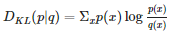
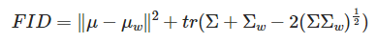
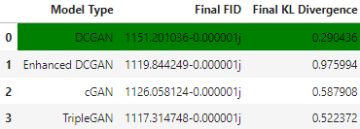
OVERVIEW
14
Fréchet Inception Distance (FID)
FID measures the distance between feature vectors of real and generated images, extracted using a pre-trained Inception network.
FID range (0 - ∞), where lower is more alike
However, the Inception Model is trained on a different dataset. Hence, it may not be the best evaluation matrix
Kullback–Leibler (KL) Divergence
It measure how the distribution of generated samples diverges from the distribution of real samples.

Slide 15
15
MODEL
IMPROVEMENT

Slide 16
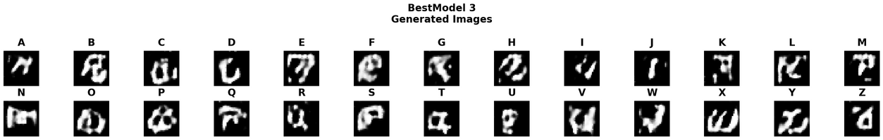
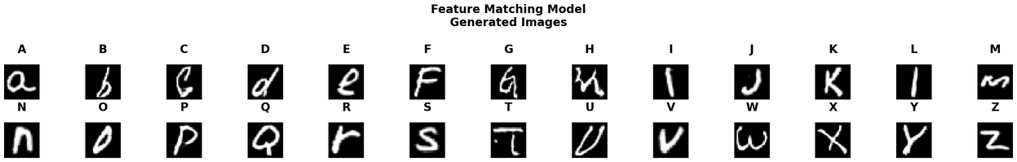
MODEL IMPROVEMENT
16
Spectral Normalization
Spectral Normalization (SN) is a regularization technique used to stabilize the training of deep neural networks. It basically addresses the most critical features of the generated images.
However, our dataset was too simple. Hence, when we implemented SN, our model focus on the obvious errors that it did not create high quality images.
Feature Matching
Feature Matching is a technique used to improve the stability and quality of generated images.
It basically points out the mistakes of the images, instead of just the discriminator saying a binary output and the generator randomly changes.
Feature Extraction:
A pre-trained feature extractor is used to extract features from both real and generated images

Slide 17

17
SUMMARY
Generating Images of a Specific Class
Use of TripleGAN / cGAN as they can take in labels of the images
Train the DCGAN on each class seperately
Classes That Are Relatively Easier/Harder to Generate
Easier Classes are like simple, well-defined characters with fewer strokes, such as 'I', 'L', 'O', and 'T'. While more complex characters with multiple strokes and curves, such as 'M', 'W', 'K', and 'R' have more intricate details, making it harder.
However, its not just about the strokes, our dataset has both uppercase & lowercase letters. The blurier the images, the more complex the class is.

Slide 18
18
REINFORCEMENT
LEANRING

Slide 19
19
BACKGROUND INFO
Balance a Pendulum
Use Cases
This task are critical in robotics, such as for self-balancing robots and robotic manipulators, as well as in aerospace engineering for stabilizing rockets and maintaining satellite orientation.
Reinforcement Learning
Challenges we may face
Exploration vs. Exploitation (Stability)
Gymnasium
We will be using a virtual environment from the gymnasium (Pendulum v0) to train our model.

Slide 20
20
TABLE OF CONTENTS
Environment Exploration
Model Selection
Model Improvement

Slide 21
21
ENVIRONMENT
EXPLORATION

Slide 22
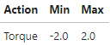
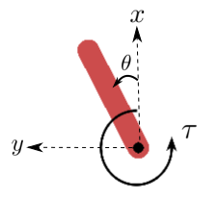
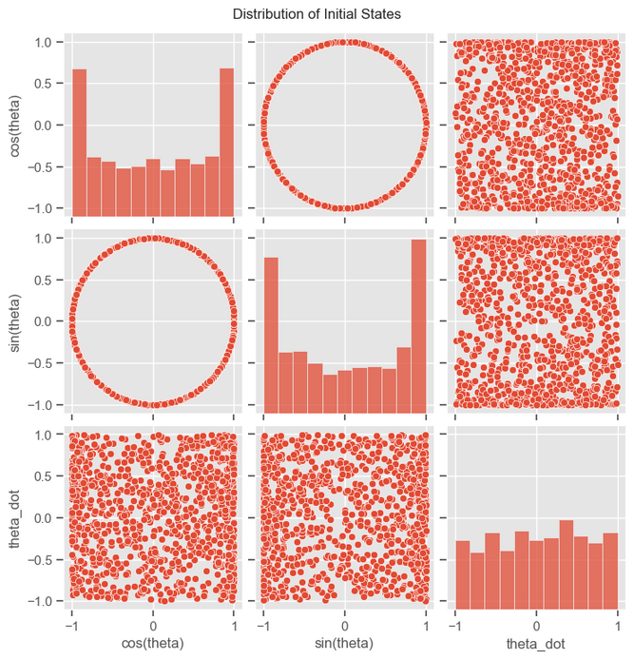
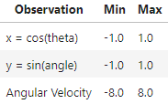
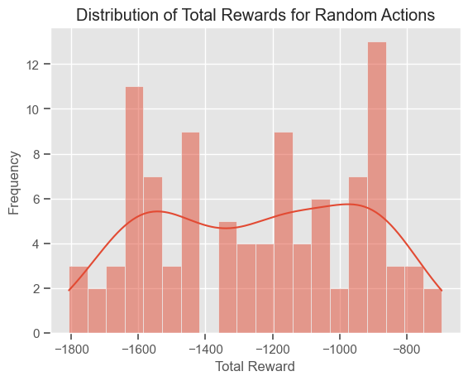
ENVIRONMENT INFORMATION
22
Pendulum v0
Initial States
x-y:
cartesian coordinates of the pendulum’s end in meters.
theta :
angle in radians.
tau:
torque in N m. Defined as positive counter-clockwise.
Objective
Swing up and balance a pendulum and Maximize cumulative reward by maintaining the pendulum upright.

Slide 23
23
MODEL
SELECTION

Slide 24
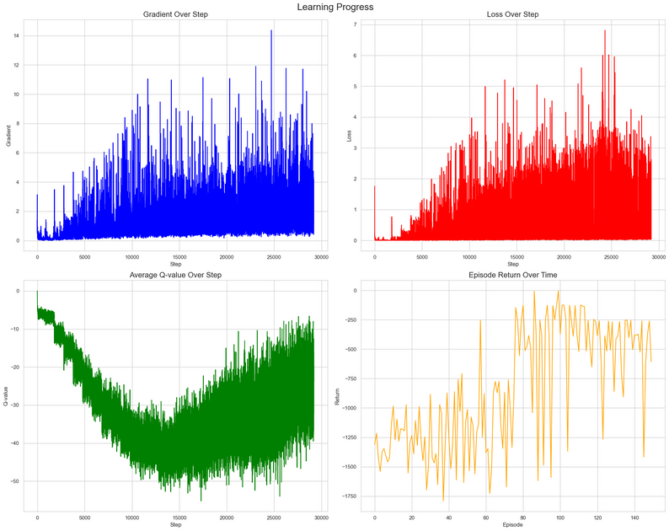
MODEL BUILDING (BASELINE)
24
Key Components of DQN
Q-Network
Input Layer: The current state of the environment.
Hidden Layers: Several layers to extract features from the state.
Output Layer: Q-values for each possible action.
Experience Replay
Replay Buffer: Stores agent's experiences (s, a, r, s').
Batch Training: Random mini-batches sampled from the buffer for training.
Target Network
Purpose: Provides stable Q-value targets.
Target Update: Updated periodically with the Q-Network's weights.
Observation
Gradient shows high variability, with spikes up to 14.
Loss gradually increases and stabilizes around 2-3.
Average Q-value initially decreases, then increases
Episode Return is highly variable, but showed an overall upward trend.
Gradient → Blue
Loss → Red
Q-value → Green
Return → Yellow

Slide 25
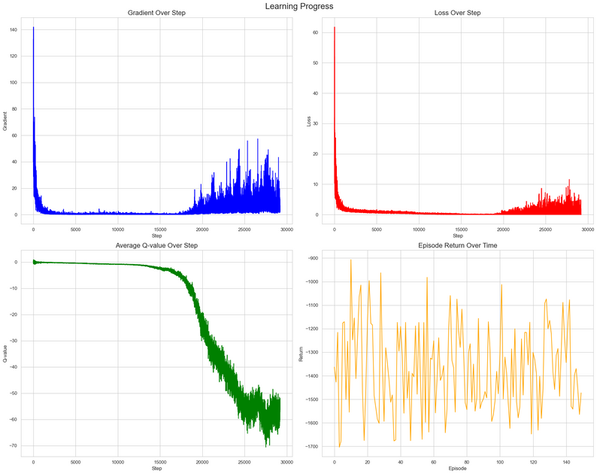
MODEL BUILDING (NOISY DQN)
25
Key Components of Noisy DQN
Noisy Q-Network
Input Layer: The current state of the environment.
Hidden Layers: Several layers to extract features from the state.
Output Layer: Q-values for each possible action, with added noise to encourage exploration.
Noisy Layers
Noise Injection: Gaussian noise is added to the weights of the neural network to create a stochastic policy.
Learnable Parameters: The parameters of the noise distribution are learned during training, enabling adaptive exploration.
Observation
Gradient initially high, then stabilizes at a low level before increasing again.
Loss starts very high, quickly drops and remains low.
Average Q-valueremains stable until around step 15000, then drops sharply.
Episode Return fluctuates but shows no clear improvement trend.
Gradient → Blue
Loss → Red
Q-value → Green
Return → Yellow

Slide 26
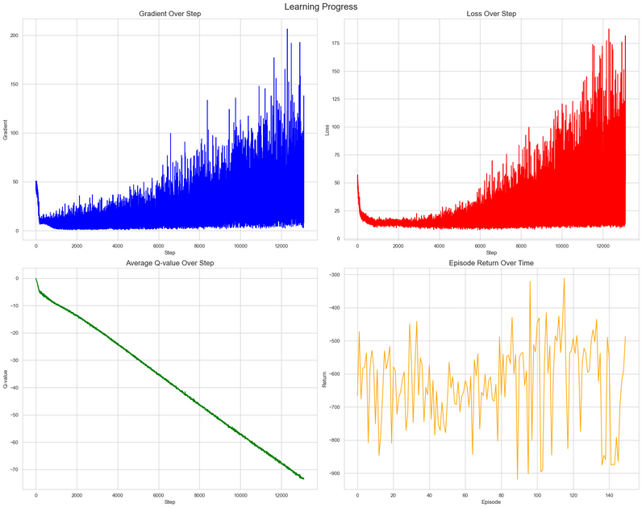
MODEL BUILDING (DDPG)
26
Key Components of DDPG
Actor Network
Input Layer: Receives the current state.
Hidden Layers: Extract features from the state.
Output Layer: Outputs a specific action for the given state.
Critic Network
Input Layer: Receives the state and action.
Hidden Layers: Processes state-action pairs.
Output Layer: Outputs the Q-value representing the value of the action-state pair.
Observation
Gradient gradually increases with high variability.
Loss initially drops, then steadily increases.
Average Q-value consistently decreases linearly.
Episode Return fluctuates but shows a slight upward trend.
Gradient → Blue
Loss → Red
Q-value → Green
Return → Yellow

Slide 27
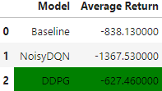
OVERVIEW
27
Noisy DQN
Evaluation:
Gradient (How quick it learns)
Average Return (How well it does)
Q-value (How well its learning)
Average Return
#1st DDPG seems to be have the lowest average return
#2nd Baseline is the most stable
#3rd NoisyDQN is the worst (Explored too much)
Although DDPG isn't very stable, with the right hypertuning & modifications to it, it can be more stable.
Baseline
DDPG

Slide 28
28
MODEL
IMPROVEMENT

Slide 29
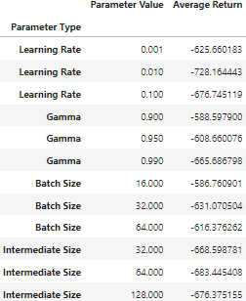
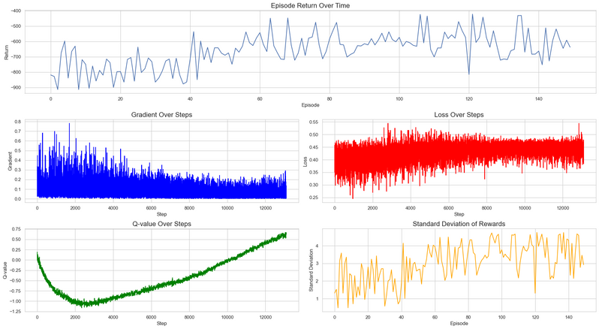
MODEL IMPROVEMENT
29
Hyperparameter Tuning
Ornstein-Uhlenbeck Process (OU Noise)
Tuning the default parameters of the model to best fit the data given
The OU process is a type of noise that is temporally correlated. It adds noise to the action outputs. This helps to improve exploration of the action space by the agent.
Parameters:
Learning Rate
Gamma
Batch Size
Intermediate Size
However, looking at the results, it still seems to be exploiting the environment still.

Slide 30
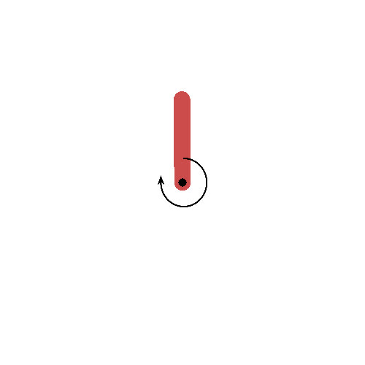
30
SUMMARY
Systematically Optimize Solutions:
Implement a structured approach such as grid search & random search to explore the hyperparameter space.
Hyper Parameters
Learning Rate
Gamma (Discount Factor)
Batch Size
Intermediate Size
Criteria Used
Gradient Magnitude
Standard Deviation of return
In reinforcement learning, Its hard to determine a good model between the best model. Due to the randomness of the environment. However, a good model should average around -100 return

Slide 31
31
THANK
YOU

